Slide 1
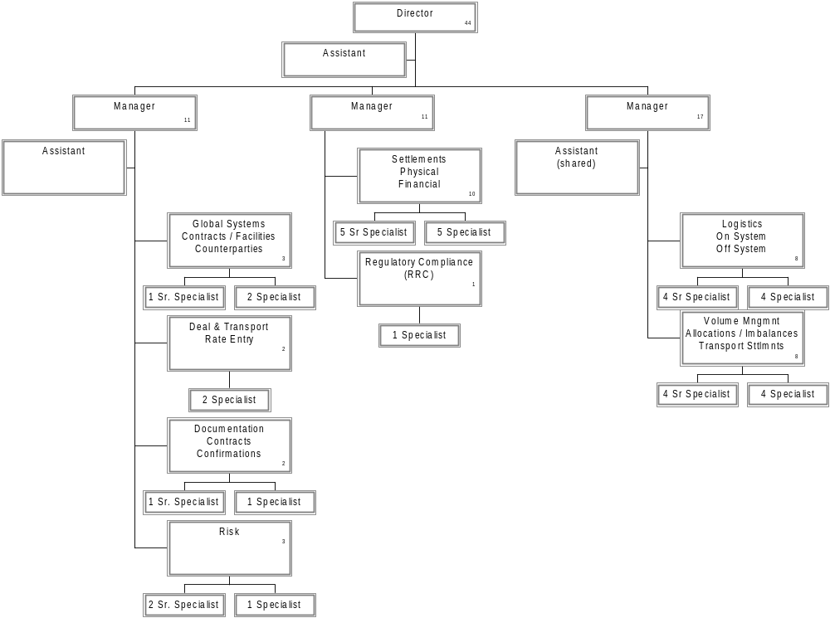
Energy Operations - HPL

